Slide 1











Philip Jennings
Community Safety Coordinator
Blanchardstown Local Drug & Alcohol Task Force
Philip@bldtf.ie Phone: 01: 8249590
REMEMBER
IT ALWAYS
HARMS SOMEONE
“THINK BEFORE YOU BUY”

Slide 2

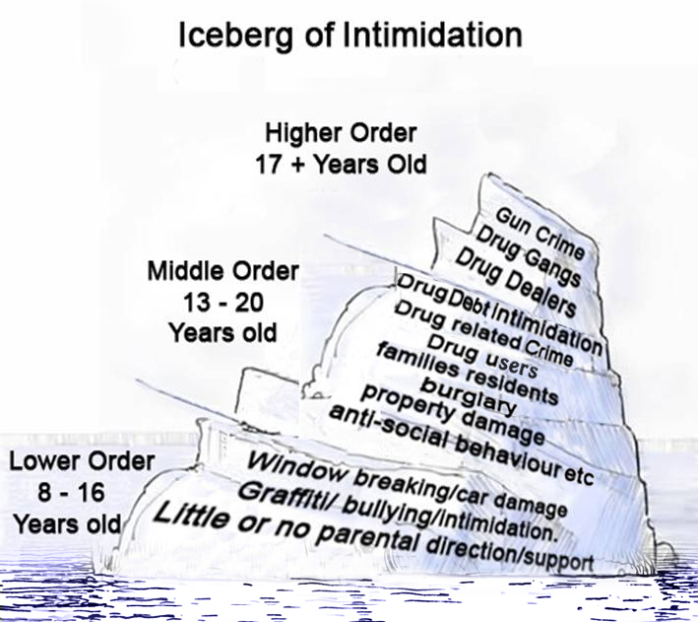
Continuum of Behaviour
Influence
Influence

Slide 3

Progression
Drug dependence
Problematic drug use
Recreational drug use
Experimentation
Continuum of Behaviour

Slide 4
Drug Related Violence
Murder
Serious Beatings
Beatings
Cut off supply
.
Continuum of Behaviour

Slide 5
How many people ?
2016: 369,000
2021 : 900,000
Women: 8% to 16%

Slide 6

Harms:
Melanie McCarthy:16
Anthony Campbell: 20
Shane Geoghegan: 28
Martin O’Rourke: 24
Trevor O’Neill: 41
Tadhg Farrell (4)
Mary Holt (60)

Slide 7
What Community Thinks
“Even more Gardaí will not solve this”
“There but for the grace of god go I, it could be
me, you or that lady over there”
“It will never be sorted there is too much money involved”
‘What can the community do, the community can do nothing”
(RTE Drive time Vox-pop)

Slide 8
Where does the problem lie?
Nature V’s Nurture
Social & Societal Problem
Package

Slide 9

RDU & U
Demand is the necessary precondition for production, distribution & supply of any product…this includes illicit drugs

Slide 10
Drug supply- importation, guns, organised criminal gangs and murder
Drug dependence – Health interventions, crime, family, friends, community, society, addiction , prison etc.
Problematic drug use – Health interventions, crime, police, intimidation, anti-social behaviour , muggings , burglaries etc.
Recreational drug use/ Influence
Under 12’s non-drug users

Slide 11
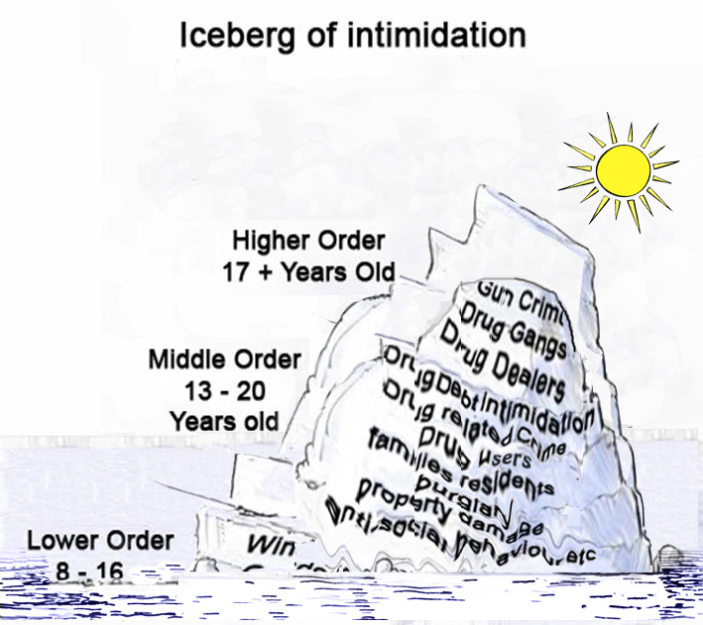
Aim: of TBYB
Existing Initiatives
To tackle the underlying cause of the drugs issue and to minimise the harms caused by the use and misuse of drugs

Slide 12
“What the community can do”
Every community member can be part of the solution by:
Challenging
Speaking
Highlighting
Encouraging
Change

Slide 13
Ask yourself
  Do I want to be part of the drug supply chain
  Do I want to contribute to violence or intimidation in my community
  Do I want to risk bringing criminals or harm to my home or family
  Do I want to be part of the problem – or part of the solution

Slide 14
REMEMBER
IT ALWAYS
HARMS SOMEONE
“THINK BEFORE YOU BUY”

Slide 15
Thank You
www.thinkbeforeyoubuy.ie
Philip@bldtf.ie

